Slide 1


VEHICLE DETECTION USING YOLO ALGORITHM
BVRIT HYDERABAD College of Engineering for Women
Department of Information Technology
Team- 15
K.Sanjana Reddy(19WH1A1219)
M.Deepthi Sharvani (19WH1A1220)
R.Rajani (19WH1A1241)
K.Aarthi (19WH1A1258)
Under the Guidance of
Guide Name:Mr.B.Srinivasulu
Designation:Assistant Professor
Department of Information Technology

Slide 2
Contents
Abstract
Introduction
Problem Definition
Literature Survey
Proposed System
Project Modules
Performance Measures
Comparsion Results
Conclusion
References
Department of Information Technology

Slide 3
Abstract
Vehicle detection in real-time is a challenging and important task.
The existing real-time vehicle detection lacks accuracy and speed.
Real-time systems must detect and locate vehicles during criminal
activities like theft of vehicle and road traffic violations with high
accuracy. We use YOLO(You Only Look Once Algorithm) to detect
vehicles effectively in real-time.
Department of Information Technology

Slide 4
Introduction
Vehicle detection in real-time is mostly helpful in detect and locate the vehicles using theft of vehicles or in violating the traffic rules which should be one with higher frequency for which we use YOLO algorithm to detect vehicles.
The network training includes vehicle-based classes datasets such as car, bus, and truck etc. Little YOLO-SPP network detects the vehicle in real-time with high accuracy regardless of video frame and weather conditions.
Department of Information Technology

Slide 5
Problem Definition
The aim is to build an automatic system that can accurately localise and track any vehicles that appear in aerial video frames.
A background subtraction technique used to detect and extract features for vehicles in complex road scenes in traffic surveillance
Department of Information Technology

Slide 6
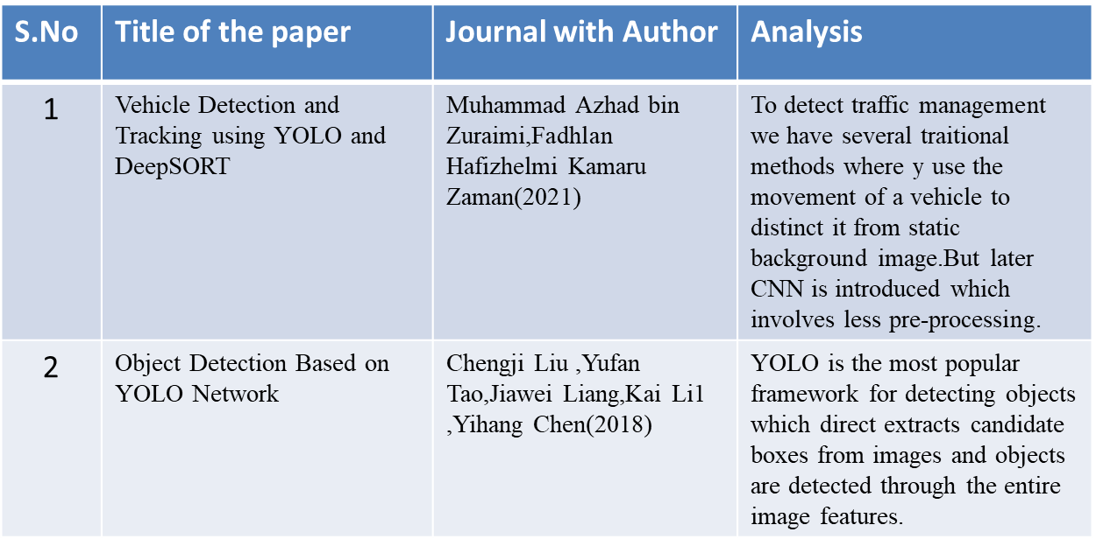
Literature Survey
Department of Information Technology

Slide 7
Proposed System
Real-time systems must detect and locate vehicles during criminal activites like theft of vehicles, traffic violation with high accuracy.
The existing real-time vehicle detection lacks accuracy and speed.
A YOLO network is proposed to detect vehicles effectively in real-time, which increases the speed and accuracy and vehicle detection.
Department of Information Technology

Slide 8
Project Modules
Drawing detection boxes
- Extracting bounding box coordinates
- Draw a bounding box and label on the frame
Box in previous frames
- Identifying if the current box was present in previous frames
Vehicle count
- Gives number of vehicles in the frame.
Department of Information Technology

Slide 9
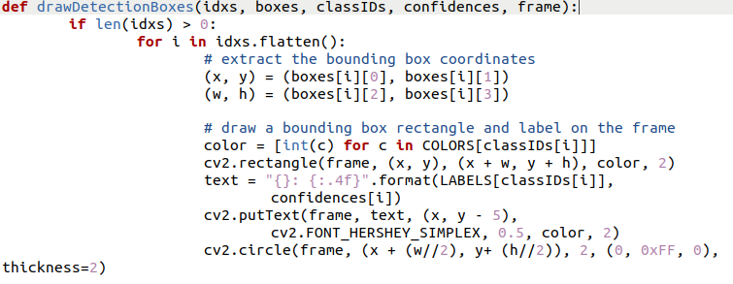
Implementation and Results
Department of Information Technology

Slide 10
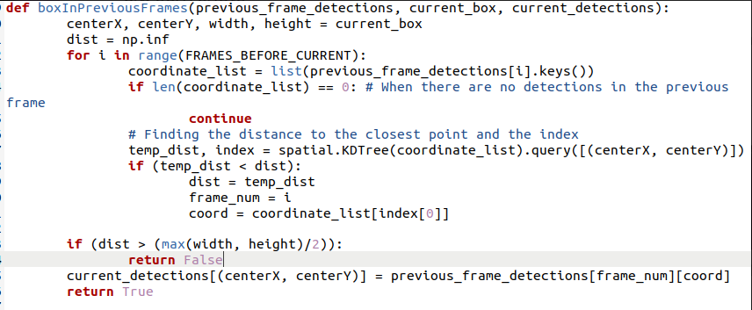
Implementation and Results
Department of Information Technology

Slide 11
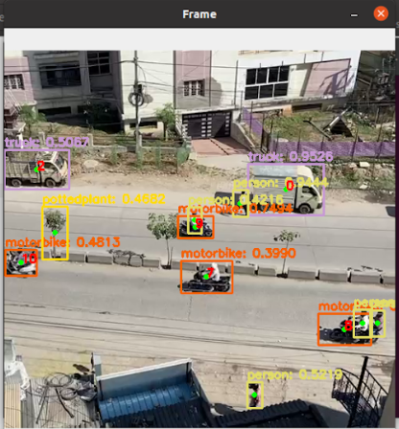
Implementation and Results
Department of Information Technology

Slide 12
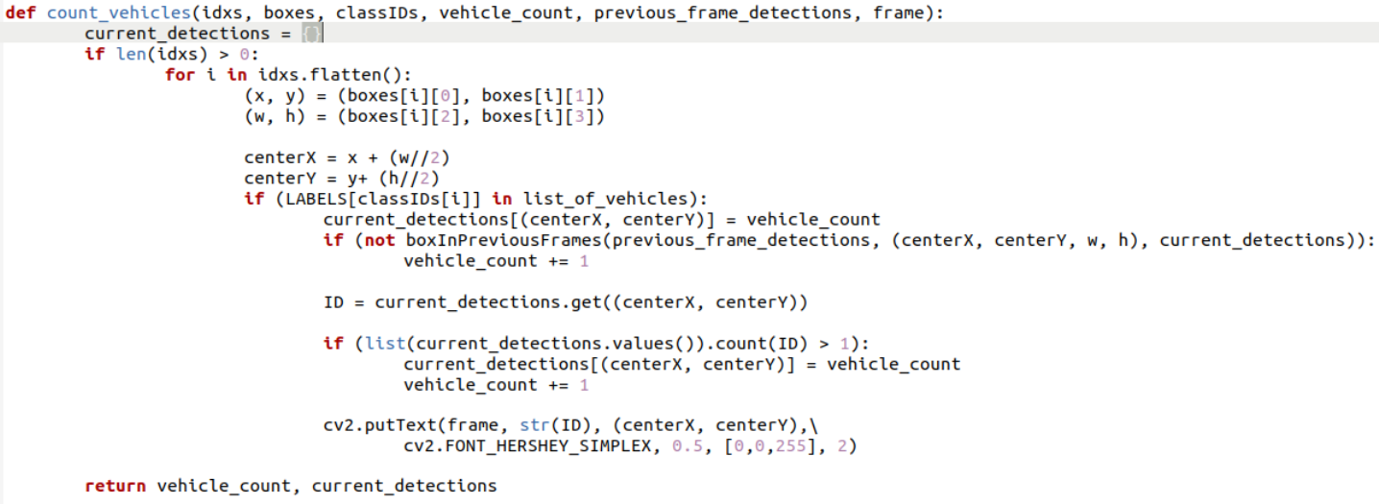
Implementation and Results
Department of Information Technology

Slide 13
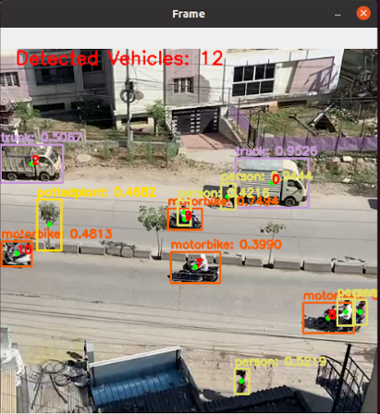
Implementation and Results
Department of Information Technology

Slide 14
Performance Measures
We have used YOLO algorithm to detect vehicles.
We calculate Confidence score, that represents how likely the box contains an object and how accurate is the boundary box . It ranges between 0-1.
Department of Information Technology

Slide 15
Conclusion
When the vehicles are in the frame, they are being detected and also being counted. This can be combined with surveillance cameras and can be used in real-time, to monitor the vehicles passing by, and their count can be helpful to set the time of traffic dynamically.
Department of Information Technology

Slide 16
References
Bin Zuraimi, M. A., & Kamaru Zaman, F. H. “Vehicle Detection and Tracking using YOLO and DeepSORT” IEEE 11th IEEE Symposium on Computer Applications & Industrial Electronics (ISCAIE) 2021. doi:10.1109/iscaie51753.2021.9431784.
Maity, M., Banerjee, S., & Sinha Chaudhuri, S.”Faster R-CNN and YOLO based Vehicle detection: A Survey. 2021” 5th International Conference on Computing Methodologies and Communication (ICCMC) 2021. doi:10.1109/iccmc51019.2021.9418274.
Peiyuan Jiang, Daji Ergu, Fangyao Liu, Ying Cai, Bo Ma ,“A Review of Yolo Algorithm Developments”The 8th International Conference on Information Technology and Quantitative Management(2021)
Department of Information Technology

